Slide 1
The Smart Unlocker
Chamara Wijesena
150698P

Slide 2
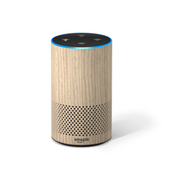
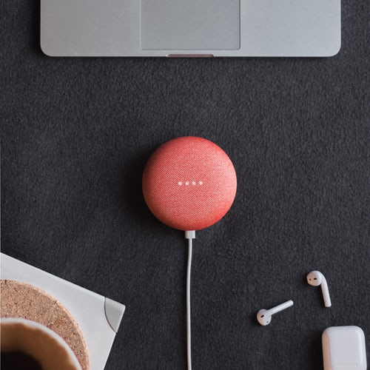
The Inspiration For the Project

Slide 3
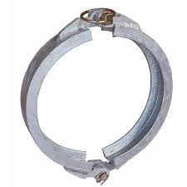
Functioning of the System

Slide 4
Mathematical model and software design
Input Stream
Data saved in a NumPy Array
Removal of noise
Removal of non vocal sound
Apply band pass filter
FFT value analysis
mean
Variance
MFCC
Threshold selection
Smooth Frames with Hanning window
mode
Authentication
Threshold match
authenticate
Learn from samples
FFT
FFT
Mel Frequency
Log
Cepstrum

Slide 5
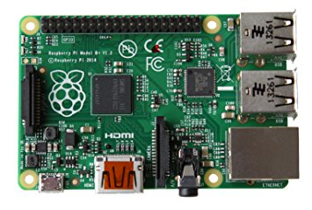

Technologies used

Slide 6
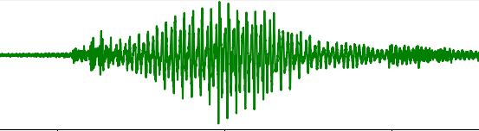
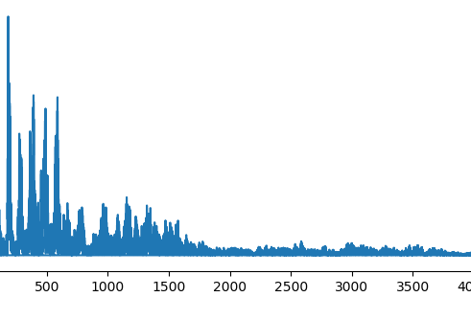
Input Stream FFT

Slide 7
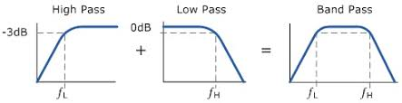
Band pass Noise Filter removal

Slide 8
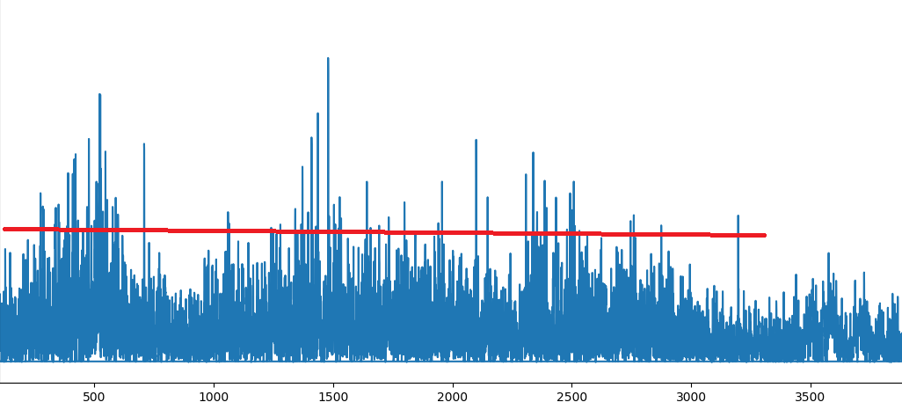
Threshold based Analyzing System

Slide 9

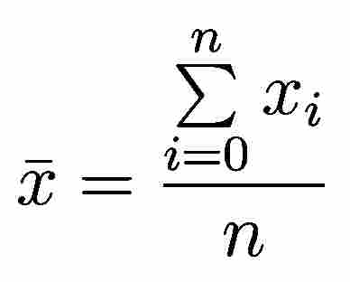

Feature Selection
-Statistical Data Analysis

Slide 10
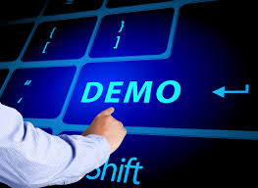

Slide 11
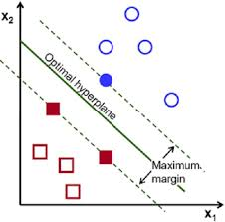
Why not use existing machine learning algorithms
Research purposes

Slide 12
Problems Arose
Integration with hardware
Less accuracy in the threshold filtering.
End up with thresholds still not stable

Slide 13

Issues In The Current System
Less accurate.
Not a standard method of speech recognition.
Voices with almost similar quality cannot be distinguished

Slide 14
Conclusion
Integration with hardware is making higher range of error.
Using an own written algorithm is not efficient to handle a big set of data.
For the further evolution of the project, machine learning algorithms can be used since the error rate is higher.

Slide 15
Thank you
?
…………

